Slide 1

Micro-architectural Attacks:
Where Security meets
Computer Architecture
Debdeep Mukhopadhyay
Professor
Secured Embedded Architecture Laboratory (SEAL)
Department of Computer Science and Engineering
IIT Kharagpur
debdeep@cse.iitkgp.ac.in
debdeep.mukhopadhyay@gmail.com

Slide 2
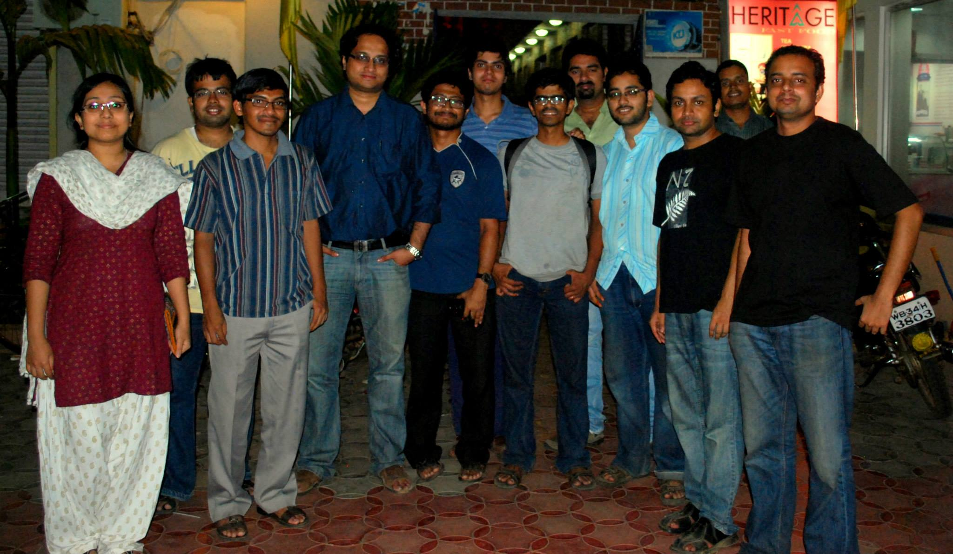
JOINT WORK WITH
Dr Sarani Bhattacharya
Prof Chester Rebeiro

Slide 3
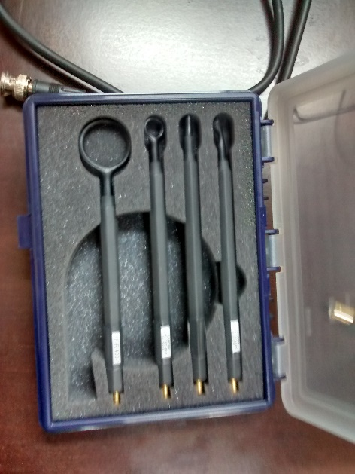
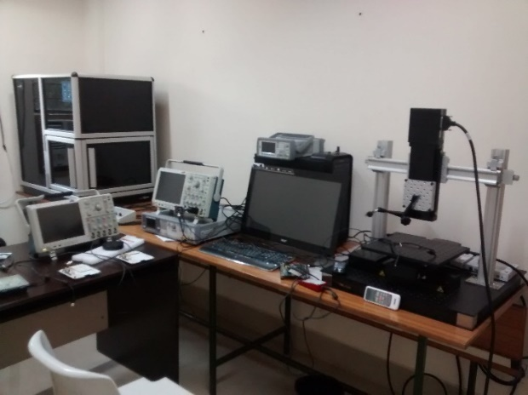
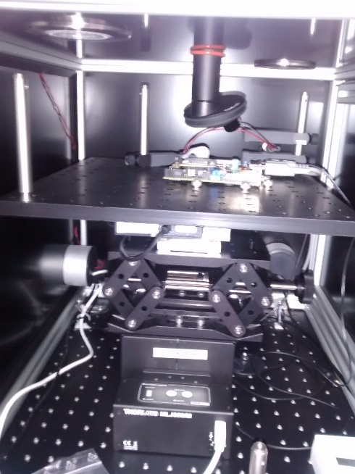
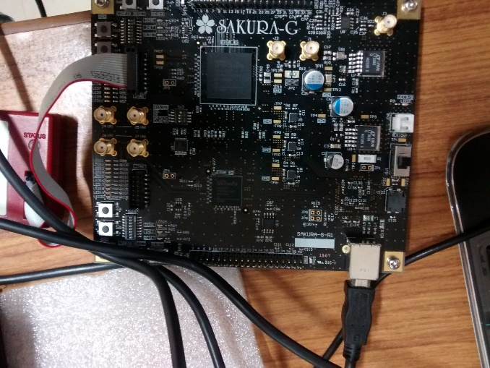
Side Channel Infrastructure at IIT Kharagpur
Power Analysis
Fault Analysis
Laser Injections
EM Analysis
Cache Analysis
http://cse.iitkgp.ac.in/resgrp/seal/

Slide 4
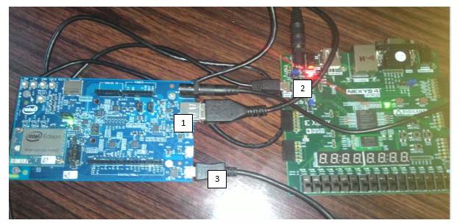


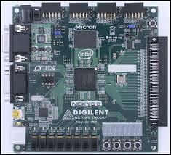
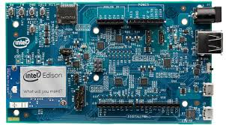
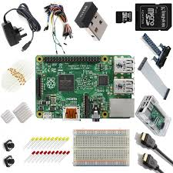
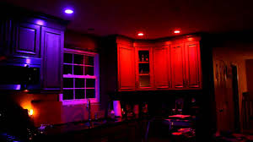

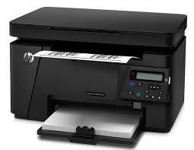
(In)Security Analysis of IoT at IIT Kharagpur
  Description
    IoT Lab introduces relatively new research platform at IIT Kharagpur which is focused towards research, learning and hands-on experimentation on the promising Internet of Things.
  On going Experiments
      Design of PUF based secure mutual authentication and communication protocol for IOT applications.
      Exploiting the security vulnerabilities in
      Philips Hue Lighting system.
      Exploiting the security vulnerabilities of
      a video surveillance system using Wifi.
  Equipments Available
      Philips Hue light system
      Intel Edison board
      Nexys 4 DDR
      Logitech HD Camera
      Rasberry Pi Kit
      HP Wireless network printer

Slide 5






Incubation on Embedded Security
Embedded Security and Privacy Pvt Ltd.
Contacts:
  Dr Debdeep Mukhopadhyay, debdeep@cse.iitkgp.ernet.in
  Dr Shivam Bhasin, NTU Singapore, sbhasin@ntu.edu.sg
Visit: http://esp-research.com/
Crypto-Libraries
Security Evaluation
Consulting and Training
Cloud Security
IoT Security

Slide 6
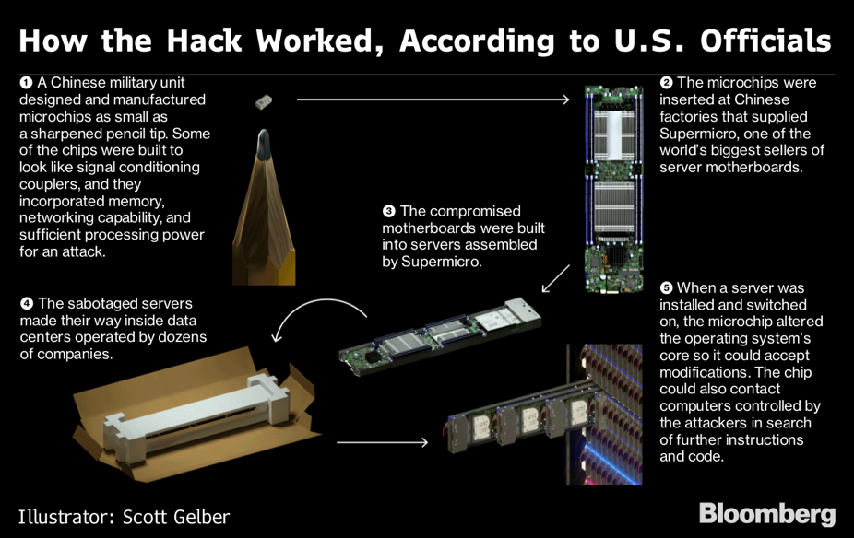
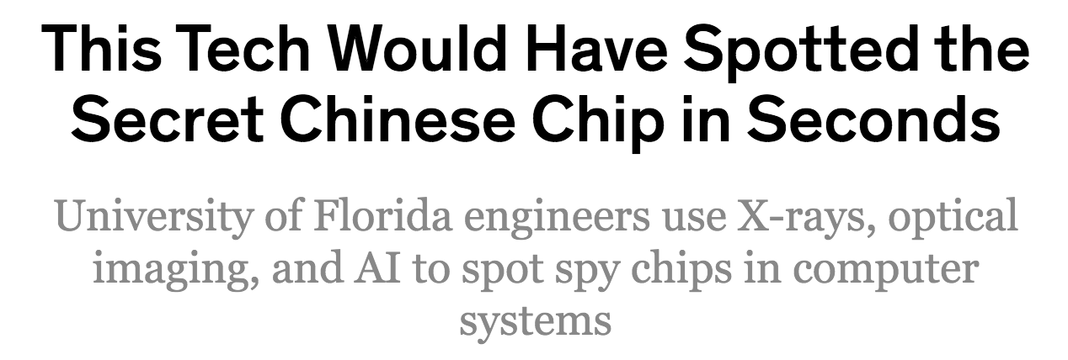

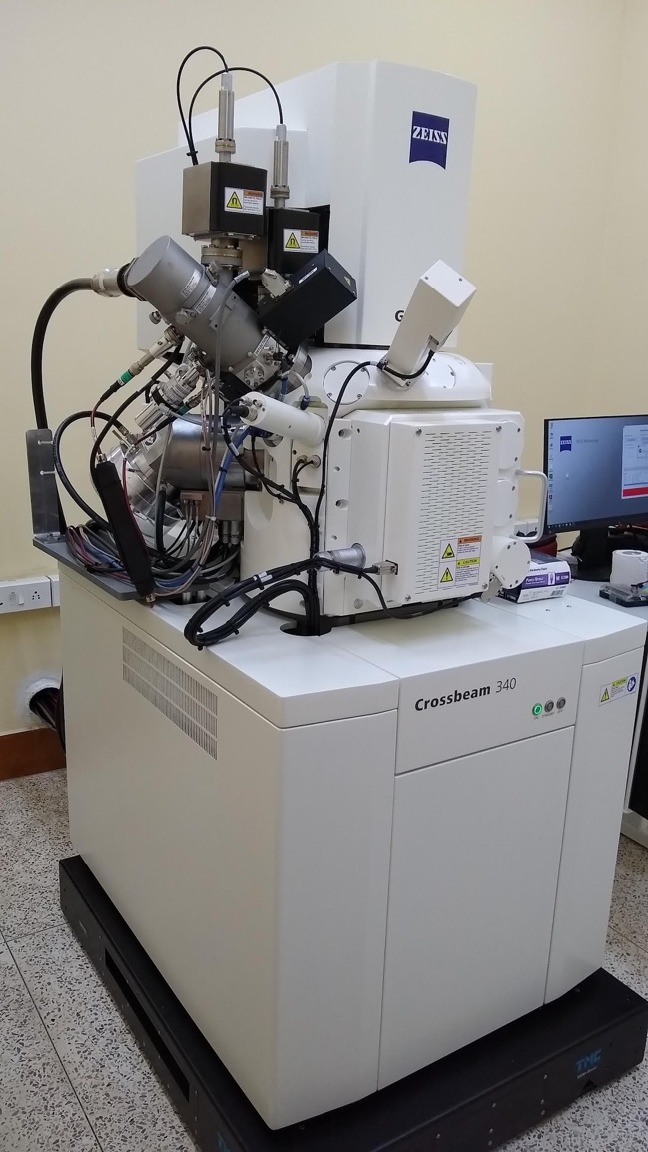
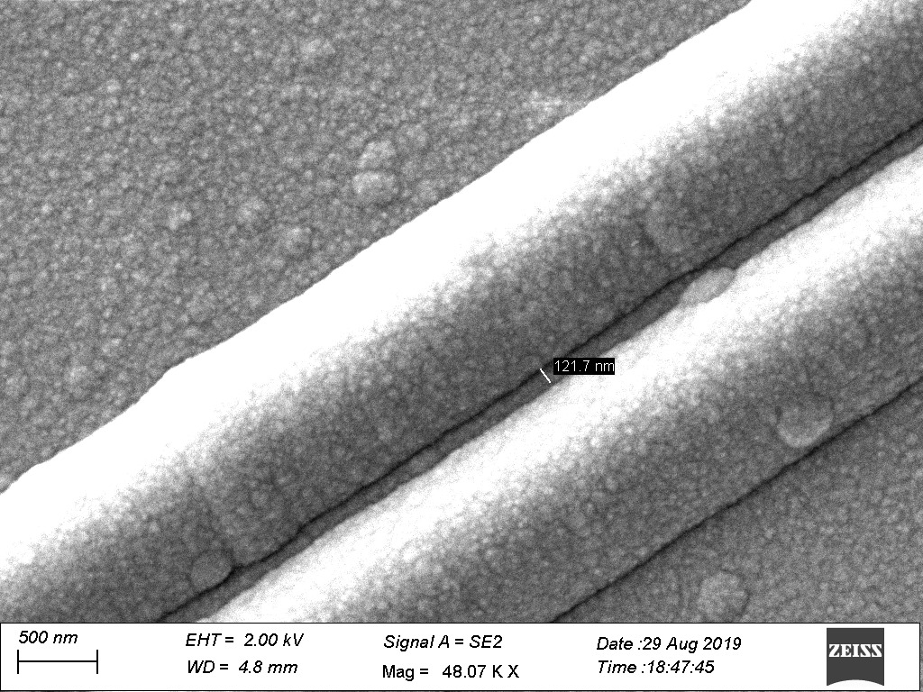
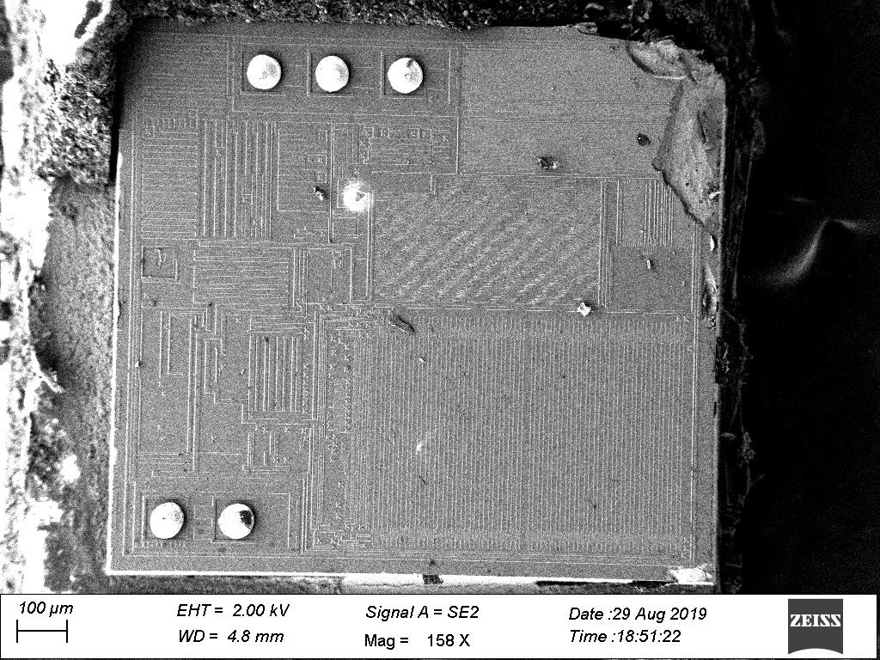
Imaging based Trojan Detection and Reverse Engineering
Recently procured FIBS/SEM installed in IIT KGP

Slide 7
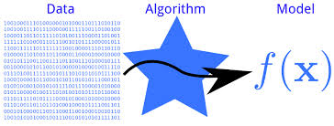

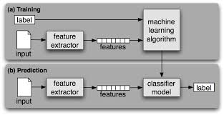








Research Focus of SEAL, IIT Kharagpur
Trojan Design
&
Detection
Micro-architectural
Attacks
VLSI
Of
Cryptosystems
Crypto-systems
for
Cloud
&
IoT
Machine Learning
for Attacks
& Defences
Physically
Uncloneable
Functions
Formal
Verification
For
Finite Field
Circuits
Countermeasure
Designs
Side Channel
Analysis
Secured Embedded
Architecture Laboratory (SEAL)
http://cse.iitkgp.ac.in/resgrp/seal/
5

Slide 8
Outline
Part I: Bird’s Eye View
Part II: Cache Timing Attacks on Block Ciphers
Part III: Quest for Ideal Implementations against Cache Timing Attacks
Part IV: Modern Times

Slide 9

Part I
Background and Bird’s eyeview

Slide 10
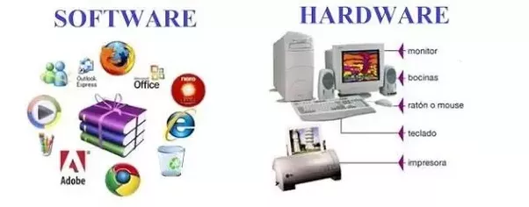
Software and Hardware
Computer hardware are the physical parts or components of a computer, such as the central processing unit, monitor, keyboard, computer data storage, graphic card, sound card and motherboard.
Software comprises of instructions that can be stored and ran by hardware.
Are they related?
Or are they two different
Disciplines?

Slide 11
Two sides of the “computation coin”
This seemingly disparate sub-disciplines of computer science, software and hardware, are intrinsically related.
Though in many schools there is an explicit marked separation and the single subject is organized for pedagogy and research as:
  Computer Science
  Computer Engineering

Slide 12
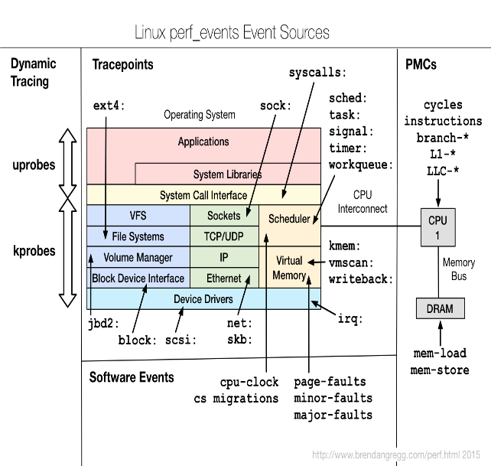

Micro-architectural Attacks:
Security cannot be an afterthought
To quote Bruce Schneier, "These are side-channel attacks where one process can spy on other processes. They affect computers where an untrusted browser window can execute code, phones that have multiple apps running at the same time, and cloud computing networks that run lots of different processes at once. Fixing them either requires a patch that results in a major performance hit, or is impossible and requires a re-architecture of conditional execution in future CPU chips. It shouldn't be surprising given that microprocessor designers have been building insecure hardware for 20 years. What's surprising is that it took 20 years to discover it."
Partitioning Ciphertexts set based on
simulated Branch miss Modelling
Strong correlation between two-bit predictor
and system branch predictor
Branch misprediction values from Hardware Performance Counter revealing the secret exponent bit of RSA
Spectre and Meltdown, Daniel Gruss, Moritz Lipp, Yuval Yarom, Paul Kocher, Daniel Genkin, Michael Schwarz, Mike Hamburg, Stefan Mangard, Thomas Prescher and Werner Haas, Google Ground Zero Project.
Sarani Bhattacharya and Debdeep Mukhopadhyay, “Who watches the watchmen?:
Utilizing Performance Monitors for Compromising keys of RSA on Intel Platforms”, CHES 2015.

Slide 13
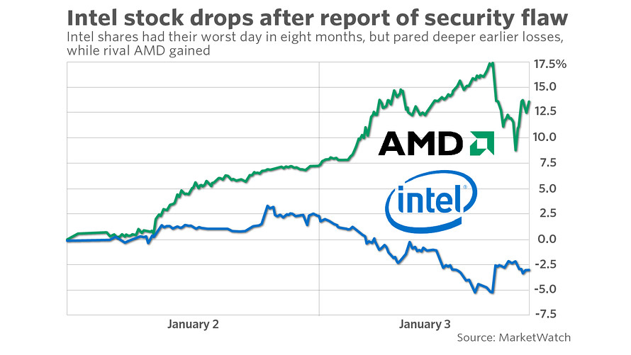
Security can be a game changer!

Slide 14
Part-II
Looking into Micro-architecture Attacks
: Timing Attacks on Block Ciphers
Chester Rebeiro, Debdeep Mukhopadhyay, Junko Takahashi, Toshinori Fukunaga:Cache Timing Attacks on Clefia. INDOCRYPT 2009: 104-118

Slide 15
What are Side Channels?
These are covert channels which leak information which the designers of cryptographic algorithms did not consider.
Information is leaked because of the implementation:
  optimization leads to information leakage
  example: an if-else statement in a programming language

Slide 16

Micro-architectural Leakage Models
Side channel leakage due to the underlying computer architecture.
However leakage (in general) can be a function of several parameters:
  Branch prediction algorithms
  Hyperthreading
  Memory Technology
  Cache Architecture
These are more relevant for software based attacks.
Our Focus
Cache
Attacks

Slide 17
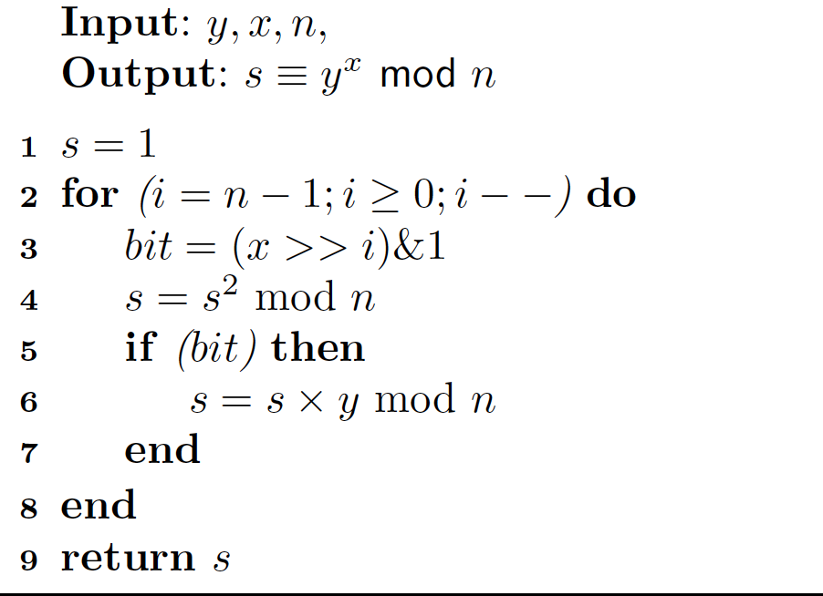
Square and Multiply Algorithm
We assume that the attacker knows the first b-1 bits, and wants to obtain the b-1th bit of the secret key.
Attacker knows x[0],…,x[b-2] and wants to determined x[b-1]
Paul C Kocher, Timing Attacks on Implementations of Diffie-Hellman, RSA, DSS and Other Systems, In Proceedings of Crypto, LNCS 1109, pgs 104-113, 1996.

Slide 18
Timing Measurement
Assume that the attacker can measure time accurately for a function P.
Compute the timestamp before and after calling a function P
Then evaluate the difference between the timestamps.
Note if there is no program between two timestamp calls, there is still a small time difference.
This overhead should be appropriately deducted after computing the running time of the program P.

Slide 19
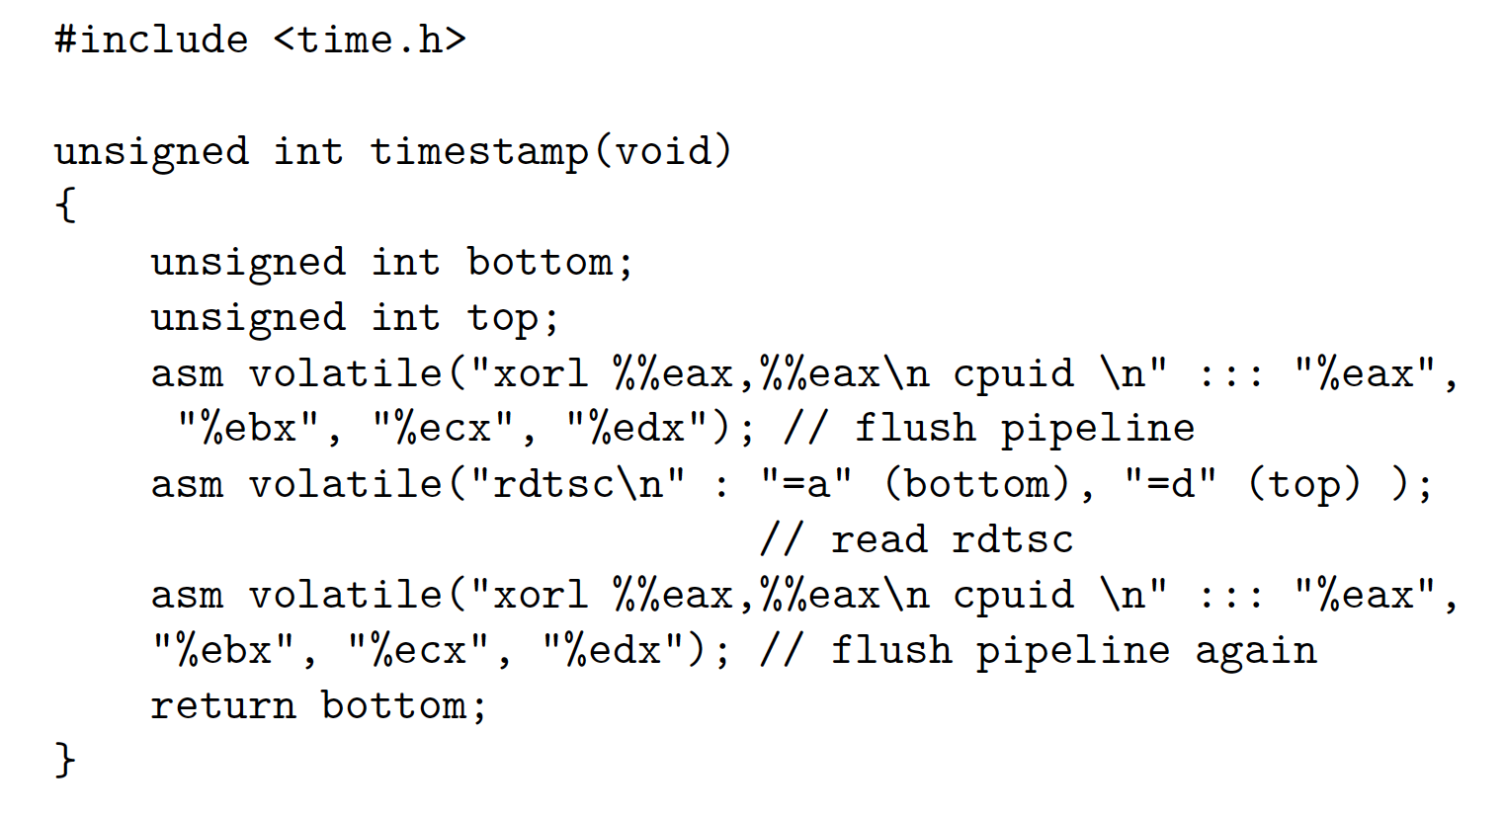
Timestamp Snippet

Slide 20
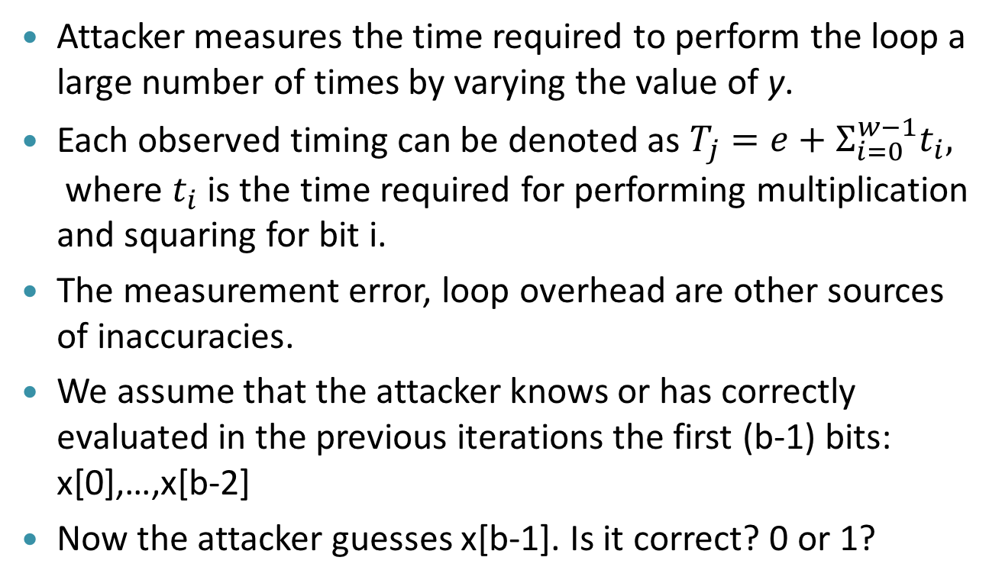
Attack Methodology
Attacker measures the time required to perform the loop a large number of times by varying the value of y.
Each observed timing can be denoted as $T_{j}=e+Σ_{i=0}^{w−1}t_{i},$where $t_{i}$ is the time required for performing multiplication and squaring for bit i.
The measurement error, loop overhead are other sources of inaccuracies.
We assume that the attacker knows or has correctly evaluated in the previous iterations the first (b-1) bits: x[0],…,x[b-2]
Now the attacker guesses x[b-1]. Is it correct? 0 or 1?

Slide 21
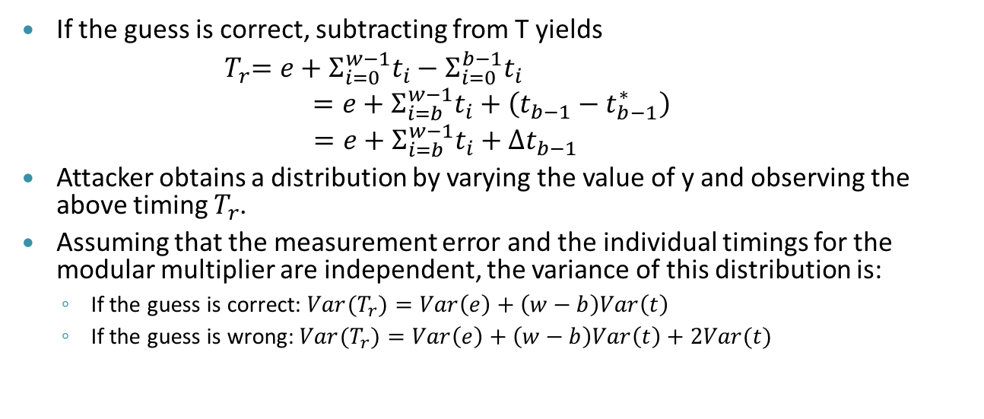
Attack Methodology (contd.)
If the guess is correct, subtracting from T yields
${ T}_{r}=e+Σ_{i=0}^{w−1}t_{i}−Σ_{i=0}^{b−1}t_{i}$
$$=e+Σ_{i=b}^{w−1}t_{i}+\left(t_{b−1}−t_{b−1}^{∗}\right)$$
$$=e+Σ_{i=b}^{w−1}t_{i}+Δt_{b−1 }$$
Attacker obtains a distribution by varying the value of y and observing the above timing $T_{r}$.
Assuming that the measurement error and the individual timings for the modular multiplier are independent, the variance of this distribution is:
  If the guess is correct: ${Var(T}_{r})=Var\left(e\right)+\left(w−b\right)Var\left(t\right)$
  If the guess is wrong: ${Var(T}_{r})=Var\left(e\right)+\left(w−b\right)Var\left(t\right)+2Var(t)$
The correct key bit is decided by observing the variance of the distribution of the time difference.
Idea used: Correct Guess => Decrease in variance

Slide 22
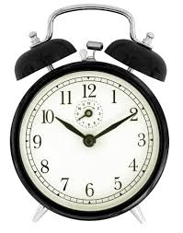
Timing Channels in Cryptography due to Cache Memories
Bob
(Cipher)
Secret
Key
(Adversary)
Microprocessor
Cache Memory
Alice
Monitor Time
Main Memory
Adversary wants to get Bob’s secret key
Why is “time” a channel for Information Leakage?
If there is a Cache Hit
  Access time is less
If there is a Cache Miss
  Access time is high

Slide 23
Time-Driven Cache Attack Principle
Part of a Cipher
(Adversary)
Table
Table
P₀
,P₄
  If cache hit (less time) :
  If cache miss (more time):
Notes:
Sbox is generally implemented as a table
23

Slide 24
Classes of Cache Attacks
Three ways to identify cache behavior
Cache Trace Attacks
Cache Access Attacks
Cache Timing Attacks

Slide 25
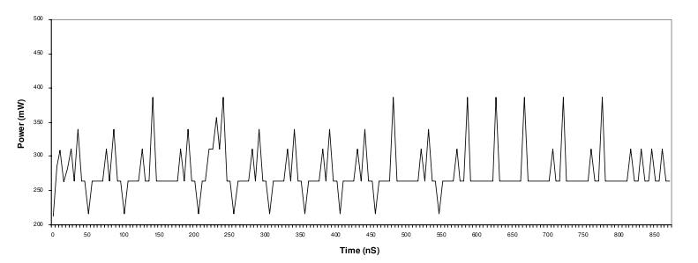
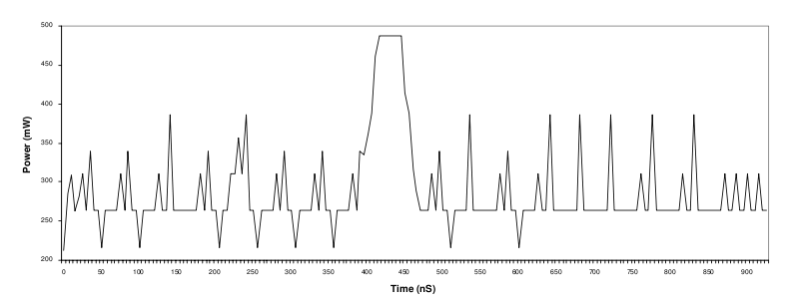
Cache Trace Attacks
The Power Profile of the system gives away cache behavior.
Without Cache Miss
With Cache Miss

Slide 26
Cache Access Attacks : Osvik’s Attack
Uses a spy program to determine cache behavior
Cache Memory
Part of the cache memory occupied by tables
Microprocessor
Cache Miss
Cache Hit
AES
Spy
Memory

Slide 27
Cache Timing Attack
Based on measuring the total time for encryption.
Used to attack a remote server.
Trigger Encryption &
Measure time taken
Network
Server running Encryption Software
Remote Attacker

Slide 28
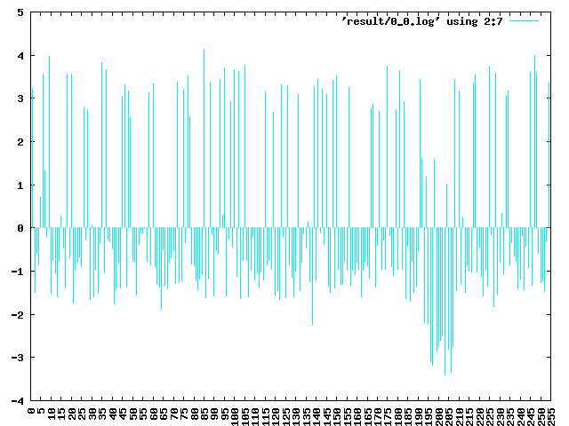

Bernstein’s Cache Timing Experiment
P0 = 00 - FF
Random
AES
Cipher Text
Characteristic of Plaintext Byte P₀
(Deviation from mean time)

Slide 29
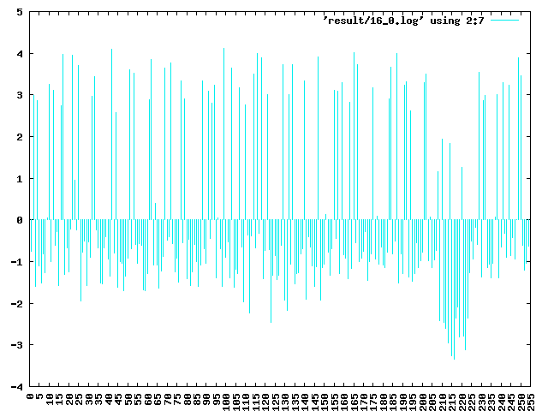
Bernstein’s Cache Timing Attack
Put key to all ZEROs and perform experiment
Repeat experiment with unknown key
Correlate the two results
29

Slide 30
Why Cache Attacks Work on AES
Substitute 16 bytes from a 256 byte lookup table
The AES Structure
  Add initial Key
  Nine Rounds of
    Byte Substitution
    Shift Row
    Mix Column
    Add Round Key
  Final Round
    Byte Substitution
    Shift Row
    Add Round Key
Chester Rebeiro, Mainack Mandal, Debdeep Mukhopadhyay, "Pinpointing Cache Timing Attacks on AES", VLSID 2010,

Slide 31
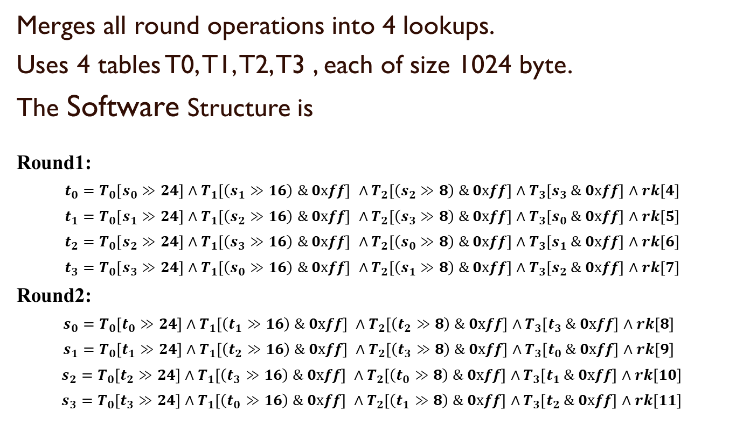
Software Implementations of AES
(OpenSSL)
Merges all round operations into 4 lookups.
Uses 4 tables T0, T1, T2, T3 , each of size 1024 byte.
The Software Structure is
Round1:
$t_{0}=T_{0}\left[s_{0}≫24\right]∧T_{1}\left[\left(s_{1}≫16\right) \& 0xff\right] ∧T_{2}\left[\left(s_{2}≫8\right) \& 0xff\right]∧T_{3}\left[s_{3} \& 0xff\right]∧rk\left[4\right]$
$t_{1}=T_{0}\left[s_{1}≫24\right]∧T_{1}\left[\left(s_{2}≫16\right) \& 0xff\right] ∧T_{2}\left[\left(s_{3}≫8\right) \& 0xff\right]∧T_{3}\left[s_{0} \& 0xff\right]∧rk\left[5\right]$
$t_{2}=T_{0}\left[s_{2}≫24\right]∧T_{1}\left[\left(s_{3}≫16\right) \& 0xff\right] ∧T_{2}\left[\left(s_{0}≫8\right) \& 0xff\right]∧T_{3}\left[s_{1} \& 0xff\right]∧rk\left[6\right]$
$t_{3}=T_{0}\left[s_{3}≫24\right]∧T_{1}\left[\left(s_{0}≫16\right) \& 0xff\right] ∧T_{2}\left[\left(s_{1}≫8\right) \& 0xff\right]∧T_{3}\left[s_{2} \& 0xff\right]∧rk\left[7\right]$
Round2:
$s_{0}=T_{0}\left[t_{0}≫24\right]∧T_{1}\left[\left(t_{1}≫16\right) \& 0xff\right] ∧T_{2}\left[\left(t_{2}≫8\right) \& 0xff\right]∧T_{3}\left[t_{3} \& 0xff\right]∧rk\left[8\right]$
$s_{1}=T_{0}\left[t_{1}≫24\right]∧T_{1}\left[\left(t_{2}≫16\right) \& 0xff\right] ∧T_{2}\left[\left(t_{3}≫8\right) \& 0xff\right]∧T_{3}\left[t_{0} \& 0xff\right]∧rk\left[9\right]$
$s_{2}=T_{0}\left[t_{2}≫24\right]∧T_{1}\left[\left(t_{3}≫16\right) \& 0xff\right] ∧T_{2}\left[\left(t_{0}≫8\right) \& 0xff\right]∧T_{3}\left[t_{1} \& 0xff\right]∧rk\left[10\right]$
$s_{3}=T_{0}\left[t_{3}≫24\right]∧T_{1}\left[\left(t_{0}≫16\right) \& 0xff\right] ∧T_{2}\left[\left(t_{1}≫8\right) \& 0xff\right]∧T_{3}\left[t_{2} \& 0xff\right]∧rk\left[11\right]$

Slide 32
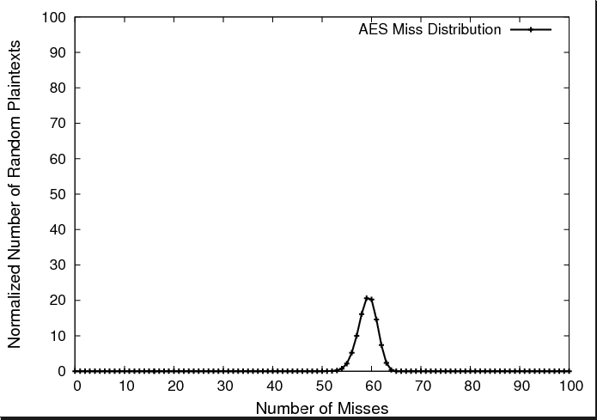
AES Execution Time for 4KB Table
Since, Nt = Nm + Nh
Cache Attack works because of varying execution time.

Slide 33
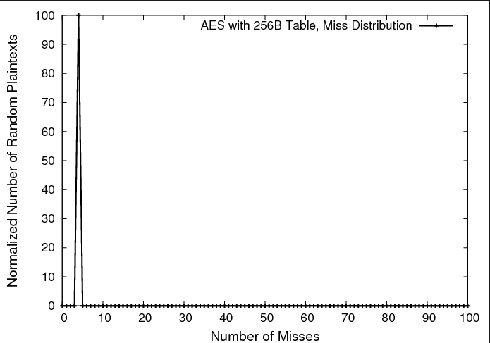
AES Execution Time with 256Byte Table
Cache Attacks
believed to be difficult
  …… Encryption Time is a constant

Slide 34
Osvik’s Attack on AES-with 256B Table
Won’t Work!!!
Cache Memory
Microprocessor
AES
Spy
Memory

Slide 35
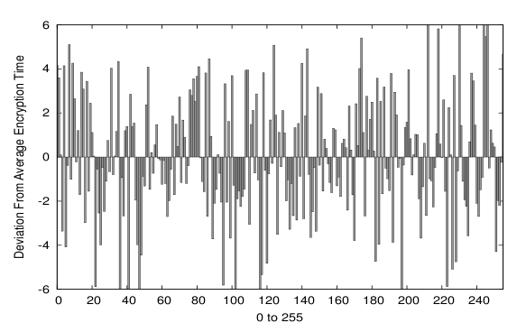
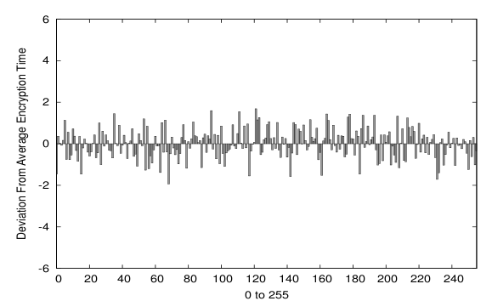
Bernstein’s Attack on Small Tables
Large
Tables
Lesser deviations in Encryption Time
Small
Tables

Slide 36
Some Opinions on Cache Timing Attacks
[Kelsey. et.al., 2000, Section 7]
“We believe attacks based on cache hit ratio in large Sbox ciphers like Blowfish, CAST and Khufu are possible”
We now show that cache attacks are possible even on ciphers with small sboxes
Chester Rebeiro, Debdeep Mukhopadhyay, Junko Takahashi and Toshinori Fukunaga, "Cache Timing Attacks on Clefia", Indocrypt 2009.

Slide 37
Analysis of Cache Timing Attacks
Processor’s aim : Reduce the miss penalty
Techniques used to achieve this are
  Speculative Loading
  Prefetching
  Out-of-order loading
  Parallelization
  Overlapping

Slide 38
Speculative Loading
Speculative Loading :Loading of data into processor before preceding branches are resolved.
  Effect on Cipher Execution :None, since branches are generally not used in block ciphers.

Slide 39
Out-of-Order Loading
Data accessed in an order not strictly specified by the program.
Program
Execution
LOAD AX, #1000
LOAD BX, #2000
LOAD CX, #3000
LOAD DX, #4000
LOAD DX, #4000
LOAD BX, #2000
LOAD AX, #1000
LOAD CX, #3000

Slide 40
Out-of-Order Loading on a Cipher
Round 1
S
S
S
S
S
S
S
S
S
S
S
S
S
S
S
S
Round 2
S
S
S
S
S
S
S
S
S
S
S
S
S
S
S
S
Out of order loading works only within a round & not between rounds.

Slide 41
Parallelization & Overlapping
Parallelization : Two or more cache misses are serviced simultaneously.
Overlapping : Memory reads are pipelined.
Effect on Cipher Execution :
Consider a 5 round block cipher with 4 misses
Time(E1) < Time(E2)
2 misses
1 miss
E1
1 miss
1 miss
1 miss
E2
1 miss
0 misses
0 misses
0 misses
1 miss

Slide 42
Extending Cache Timing Attack to
Work on Small Table Ciphers
Challenges:
1. The deviation in encryption time is too less.
2. Timing measurements need to be more accurate.

Slide 43
Improvements to the Timing Attack (1)
Improving Timing Measurements
  Use ‘RDTSC’ instruction to measure timing.
    This is prone to errors due to processor pipeline and out-of-order execution.
  Also use ‘CPUID’ before calling RDTSC
    This flushes the processor pipeline.
    Hence all RDTSC instructions done on a fresh pipeline.

Slide 44
Improvements to the Timing Attack (2)
P0
P1
P2
P3
K0
K1
K2
K3
XOR
XOR
XOR
XOR
S1
S2
S1
S2
Vary only those bytes which go to the same sbox as P0.
Constant
P0 = 00 - FF
Random
AES

Slide 45
Attack on CLEFIA
CLEFIA is a block cipher designed by Sony Corporation
It has small tables of 256 bytes.
There are 18 rounds in the cipher
  each round has 8 look-ups
  there are 2 S Boxes of 256 bytes
  Thus there are 4 look-ups per S-box in each round.

Slide 46
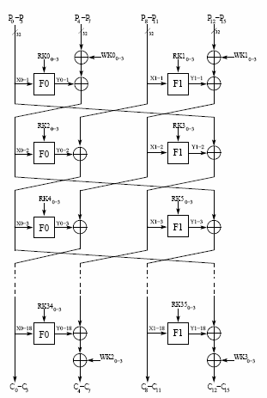
CLEFIA Attack Results
On Intel Core 2 Duo, the first phase of the attack takes 1300 seconds,
Second phase (with secret key) takes 312.5 seconds
The attack has also been tested successfully on
Pentium 4
Intel Atom
Xeon – Core 2 Server
The attack fails on Pentium 3
Chester Rebeiro, Debdeep Mukhopadhyay, Junko Takahashi and Toshinori Fukunaga, "Cache Timing Attacks on Clefia", Indocrypt 2009.

Slide 47
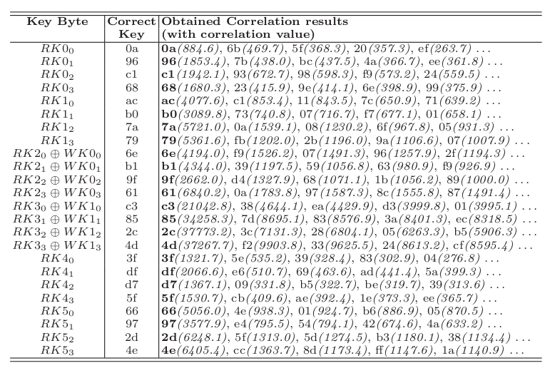
Correlation Results on CLEFIA
47

Slide 48
Part-III
Looking into Micro-architecture Attacks
: An Ideal Implementation for Cache Timing Attacks
Chester Rebeiro, Debdeep Mukhopadhyay:Micro-Architectural Analysis of Time-Driven Cache Attacks: Quest for the Ideal Implementation. IEEE Trans. Computers 64(3): 778-790 (2015)

Slide 49
Ideal Implementation against Time-Driven Cache Attacks
P₀
P₄
Random
  Suppose
  (K₀ = 00 and K₄ = 50)
P4 | Average Time | DOM
00 | 2945.3 | 1.8
10 | 2944.4 | 0.9
20 | 2943.7 | 0.2
30 | 2943.7 | 0.2
40 | 2944.8 | 1.3
50 | 2937.4 | -6.3
60 | 2943.3 | -0.2
70 | 2945.8 | 2.3
: | : | :
F0 | 2941.8 | -1.7
P₀ = 0, all other inputs are random
Make N time measurements
Segregate into Y buckets based on value of P₄
Find average time of each bucket
Find deviation of each average from overall average (DOM)
Block Cipher
Cipher Text
P₀
P₄
K₀
K₄
T
T
Average : 2943.57
Maximum : -6.3

Slide 50
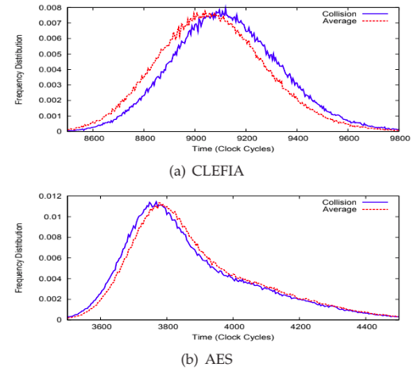
Different DOM for Different Implementations
Implementation | Difference of Means
AES (OpenSSL 0.9.8a ) | -6.5
DES (PolarSSL 1.1.1 ) | +11
CAMELLIA (PolarSSL 1.1.1) | 19.2
CLEFIA (Ref. Implementation 1.0) | 23.4
Easiness to attack

Slide 51


Effect of Micro-architecture in Cache Memory in Superscalar Processors
Snippet A
Snippet B
Assume the cache is clean before executing a snippet
Which is faster?
Snippet A !!!
In Superscalar processors cache misses can be
pipelined and parallelized provided there are no memory
dependencies

Slide 52
Which Implementation is Faster in a Superscalar Processor?
Snippet A
Snippet B
time
time
Cache misses in Snippet A can be
pipelined and parallelized

Slide 53
Memory Access in a Cipher
Round 1
T
T
T
T
T
T
T
T
T
T
T
T
T
T
T
T
Round 2
T
T
T
T
T
T
T
T
T
T
T
T
T
T
T
T
Round 1
Round 2
In a cipher, memory accesses within a round can
be parallelized and pipelined. But memory accesses
across rounds should be serialized

Slide 54
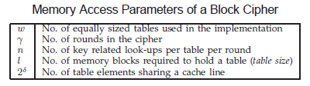
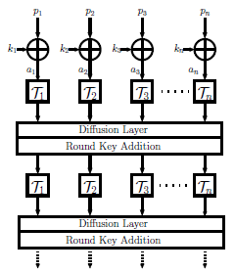
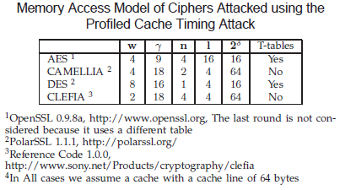
A Model for Block Cipher Implementations
Table Accesses

Slide 55
Finding the Ideal Implementation
Estimating the difference of means
Estimate the execution time with a collision
Estimate the execution time without the collision
Find the difference

Slide 56
Time for a Round of Execution
is the latency for the first miss
the number of cache misses in the round
the latency for the subsequent misses

Slide 57
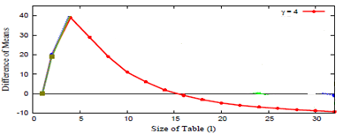
Ideal Implementation
Ideal
Micro-architectural features
have a high influence on DOM
(such as in CLEFIA)
Table size influences
the DOM
(such as in AES)
Chester Rebeiro, Debdeep Mukhopadhyay:Micro-Architectural Analysis of Time-Driven Cache Attacks: Quest for the Ideal Implementation. IEEE Trans. Computers 64(3): 778-790 (2015)

Slide 58
A Model for Block Cipher Implementations
Table Accesses

Slide 59

Average Cache Misses per Round (m_{r})
Mathematical Model
Access/Round
Size of Tables
Round Number
Average
Cache Misses for the round
Cache Line Size

Slide 60

Average Time for Encryption
Average time for Round 1
Average time for Round 2
Average time for Round 3
Average time for Round 4
Total time for Encryption
Average time for Last Round

Slide 61
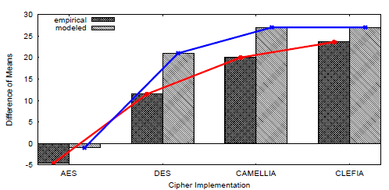
Comparing Cipher Implementations
Test Platform :
  8 core Intel Xeon 2.13GHz
  Depends on the executing core
Cipher Implementations
  AES - OpenSSL (0.9.8ka)
  DES - PolarSSL (1.1.1)
  CAMELLIA - PolarSSL (1.1.1)
  CLEFIA – Reference Code of Sony (1.0)

Slide 62
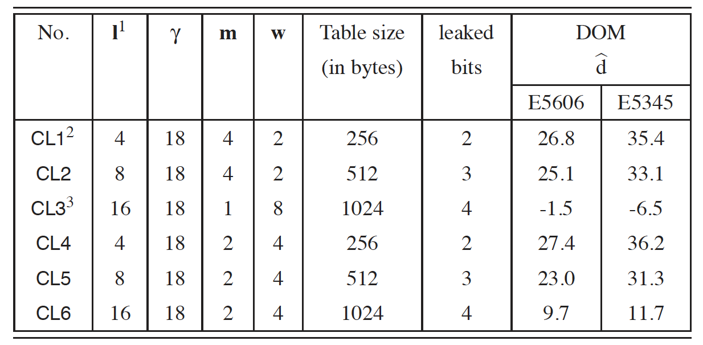
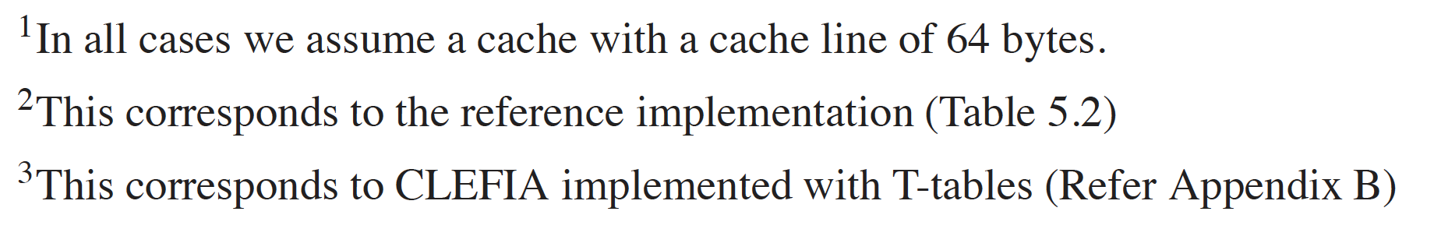
Different Avatars for Clefia

Slide 63
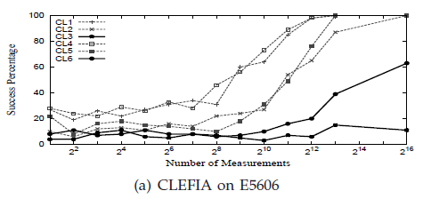
Practical Validations
Success of the Attack vs Number of Measurements Made
Implementations identified by
the mathematical model
are more difficult to attack

Slide 64
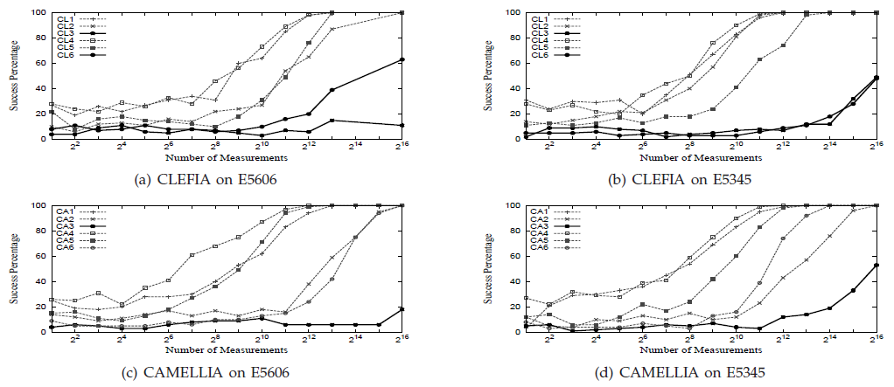
More Experiments
With CLEFIA and CAMELLIA on different platforms
Test platform E5606: Intel 8 core Xeon 2.13GHz, running Ubuntu 12.04
Test platform E5345 : Intel 4 core Xeon 2GHz, running Fedora OS

Slide 65
Two Sources of Leakage
In superscalar processors there are two sources of leakage
  Leakage due to cache misses has a negative effect
  Leakage due to micro-architectural features has a positive effect
Ciphers can be designed so that the two leakages cancel each other
This allows building implementations more protected against time-driven cache attacks

Slide 66
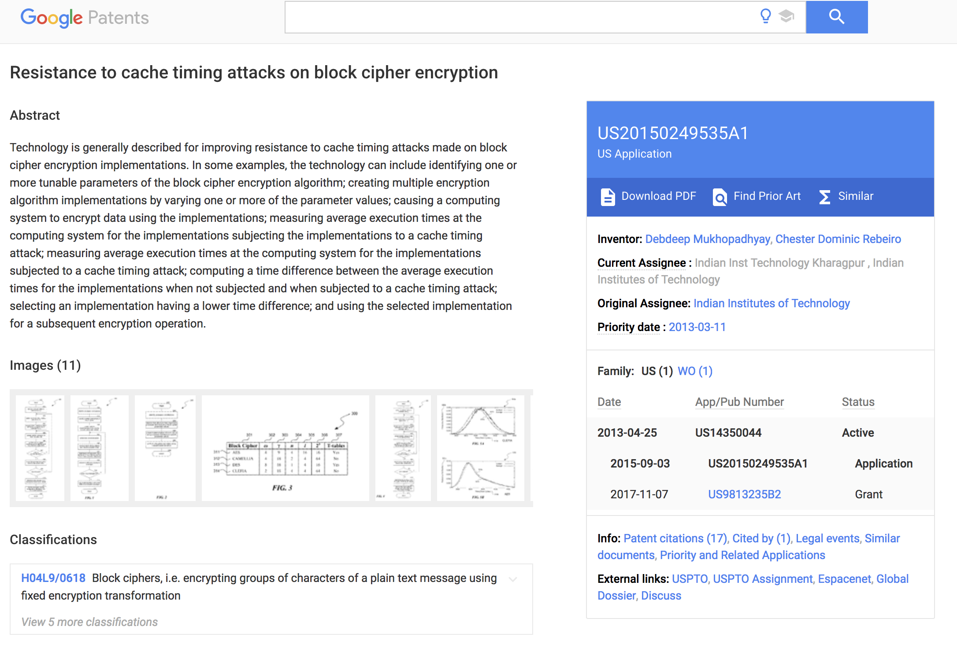
Patent

Slide 67

Part-IV
Modern Times:
Timing Attacks in Modern Systems

Slide 68
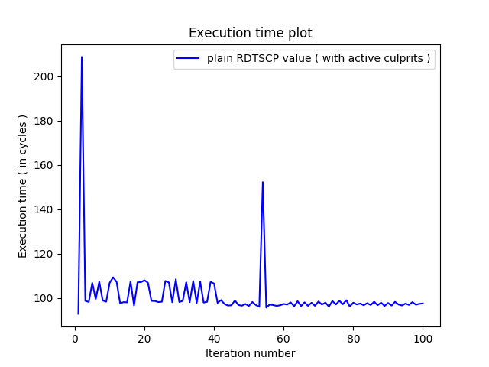
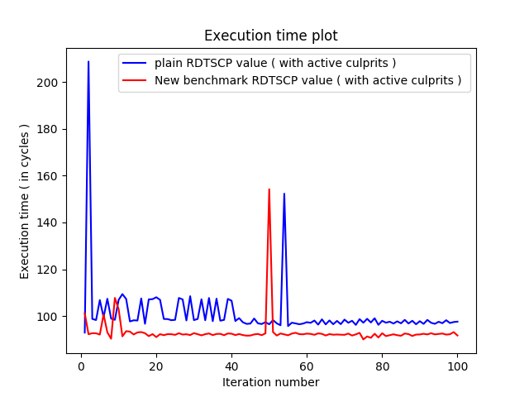
Timing Attack in Modern Systems
In modern day systems timing attack faces difficulties because of the modifications for performance improvements.
Timing measurements for the execution of a same instruction with RDTSCP creates different timing values at different instances.
New RDTSCP benchmark code
generates similar timing
measurements.

Slide 69



Timing Attack in Modern Systems
Nondeterminism
(performance improvements)
eliminate
disable
disable
Can be done
from USER space
disable
Requires
ROOT ACCESS

Slide 70

Timing Attack in Modern Systems
How to Benchmark Code Execution Times on Intel® IA-32 and IA-64 Instruction Set Architectures - Gabriele Paoloni (White Paper)
Removes all Nondeterminism
(with root access)

Slide 71

Timing Attack in Modern Systems
Eliminate nondeterminism due to hyper-threading from user space
Spy thread keeps one virtual core occupied and lets other thread run solely on other virtual core
Core
Virtual Core 0
Virtual Core 1
Spy thread
while(1){;}
Time measurement thread
start = time_fn()
/*function*/
end = time_fn()
timing = end - start

Slide 72


Timing Attack in Modern Systems
Timing Attack on Modern System (Core i5)
Accuracy 0%
After Removing all Indeterminism
Accuracy around 60%

Slide 73



Timing Analysis for Row Hammering
Cache Memory
Cache Miss
DRAM
Crypto execution

Slide 74
Timing Analysis for Row Hammering
Slice 0
Slice 1
Slice 2
Slice 3
Copies data to indexed cache set and slice
Rank
Banks
DRAM access on cache miss
Rows

Slide 75

Timing Analysis for Row Hammering
Spy fills the cache sets with its own data
Once data in cache, access to same data results in Cache Hit
Slice 0
Slice 1
Slice 2
Slice 3
Next access results in Cache Miss
Concurrent accesses to DRAM banks to enforce rowbuffer collision
Rank
Banks
Access to DRAM on cache misses imposed by spy
Rows

Slide 76


New Frontiers of
Micro-Architectural Attacks
.
Jump over ASLR
CacheBleed
Bypass existing Address Space Layout Randomization schemes by exploiting a side-channel created through shared BTB
Targets OpenSSL 1.0.2f RSA modular exponentiation on Intel processors using cache bank conflict

Slide 77



New Frontiers of
Micro-Architectural Attacks
Exploiting Speculative Execution
01
Spectre: uses branch misprediction and out-of-order execution to access unprivileged data.
02
Meltdown: uses out-of-order execution and prime-probe method to access kernel pages
03
Foreshadow: uses L1TF and page fault along with meltdown to retrieve data across SGX enclaves.

Slide 78
Conclusions
Micro-architectural attacks encompasses the intersection of architecture and computer security.
Architectures have been developed to enhance performance:
  Cache memories
  Prefetchers
  Out of order execution
However leakage due to architecture is not yet a guideline for design.
More attacks are emerging and security is getting to be a game changer: Design-for-Security along with other objectives like performance, power, energy.
  Good time to think of clean paper designs for secured computer architecture
  RISC-V is a good open source platform to experiment.

Slide 79



Thank You for your attention!!
Ref: Viewpoint, By Leah Hoffmann Communications of the ACM, June 2018, Vol. 61 No. 6, Pages 104-ff10.1145/3204453 .

Slide 80


Proceedings in Springer LNCS
Please visit us at: https://www.isical.ac.in/~space2019/index.html

Slide 81

Text Book on Timing Attacks
Discusses various timing attack algorithms in detail allowing readers to reconstruct the attack.
Presents the application of timing attacks on remote systems and cloud environments.
Examines information leakage models that would help quantify leakage in a covert timing channel

Slide 82

Text Book on Fault Attacks
Reviews exhaustively the recent key research into fault tolerant architectures in hardware security and cryptography software
Discusses the latest fault attacks on a wide variety of cryptographic implementations, such as biased fault attacks, algebraic fault attacks, and attacks on authenticated encryption based ciphers
Offers hands-on and practical demonstrations for handling complex secure cryptographic architectures, complementing the theoretical analysis

Slide 83

MOOC Course on Hardware Security
https://www.youtube.com/watch?v=xwgecIX3E4I&list=PLbRMhDVUMngfulSvKL0cT-tn8ULtERsWk&index=1

