Slide 1
Securing modern high-performance processors challenges and possible solutions.
1st Workshop on Micro-Architectural Security
October 11 -12th IIT Madras
Prof. Avi Mendelson, IEEE Fellow
Technion, Israel and NTU
avi.mendelson@technion.ac.il avi.mendelson@ntu.edu.sg
This work was partially supported by a grant from
- the Hiroshi Fujiwara cyber security research center, Technion, Israel.
- the Singapore National Research Foundation (“SOCure” project) – NRF2018NCR-NCR002-0001

Slide 2
Agenda
Intro
What can we learn from error/fault handling in modern systems
Implications on security
New approach proposal
Dynamic protection mechanisms
Example – the SoCure project
Conclusions and next steps

Slide 3


Security of modern systems
Speculation is one of the most noticeable means to gain performance in HPC systems
Speculative execution leaks information since it creates “observable dependencies” with the data it executes (to be extended)
Systems are becoming extremely sophisticated and complicated so the probability for bugs cannot be ignored
Security attacks are becoming a “profitable business” and so, individuals, companies and even armies/countries are spending much effort (and money) to “improve” it.
Self-driving cars

Slide 4
Classes of “attack vectors”
Non-invasive attacks (low-cost)
  observe or manipulate with the device without physical harm to it
  require only moderately sophisticated equipment and knowledge
  to implement
Invasive attacks (expensive)
  almost unlimited capabilities to extract information from chips and
  understand their functionality
  normally require expensive equipment, knowledgeable attackers
  and time
Semi-invasive attacks (affordable)
  semiconductor chip is depackaged but the internal structure of it
  remains intact
  fill the gap between non-invasive and invasive types, being both
  inexpensive and easily repeatable
Countermeasures should be correlated with the assumed attach vector

Slide 5
Non-invasive attacks
Software attacks
  use the normal communication interface and exploit security vulnerabilities
  found in the protocols, cryptographic algorithms, or their implementation
Fault generation (can be invasive or non-invasive)
  use abnormal environmental conditions to generate malfunctions in the
  system that provide additional access
Side-channel attacks
  Indirect way of extracting (secure) information
Human factors -- RTFM
  Since many vulnerabilities are due to human mistake. Inside information can helps
  Many times specifications are not complete and/or engineers do not stickily implement the specifications. So deep understanding “what may happen” can help
Extremely important when systems become complicated and develop by different “entities”

Slide 6
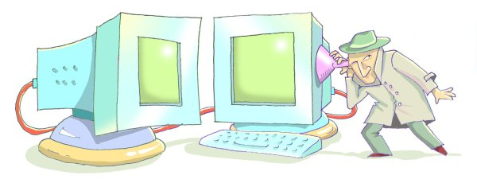
Side-channel attacks
The goal is to find dependencies between “measurable parameters” and “secretes”
We can inject faults to help the process
Notice – in order to “break a code”, it is enough to reduce the “solution space”
to a size we can exhaustively search in a reasonable time

Slide 7
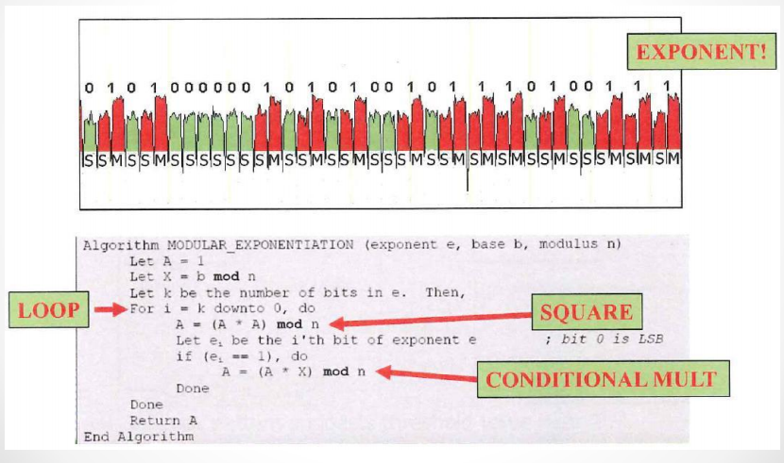
Simple power analysis -- RSA Conditional Branch
“White box attack”

Slide 8
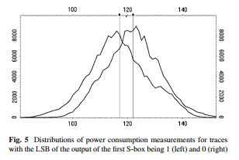
DPA – Differential Power analysis
DPA is mainly used for “black box” model where you know little (if at all) on what the system is executing (but you may have a good model on the hardware itself.)
We may observe (or guess) that on-average, the power of
the system when execute some values (e.g., “0”) is
different than the power when execute other values
(e.g., “1”)
We are using distribution of many
samples
We care of the average behavior not
on understanding a single measurement; e.g., when
using OOO cores, each execution may consume
different amount of power. Still the average of
executing some values may be different than the
average of executing other values
Can be “Black box” attack

Slide 9
Timing based attacks - simple example
Cache is great for performance but problematic for security since “keep traces”
Here, two threads
  Thread 1 fill out the cache
  Allows Thread 2 to operate
  Thread 1 check which of his cache lines were replaced.
    HOW? Access the data and observe how long it take you to retrieve the data (cache hit or miss)
  Does it expose the secret key ?
    Not directly
    It reduces the search space to a manageable size that can be exhaustively searched.
S-box
table
DRAM
cache

Slide 10

Exclusive summary - Spectre and Meltdown
Spectre and Meltdown are vulnerabilities that allow user level code (unprivileged) to indirectly read data from all physical pages
(including privilege pages and pages belonging to other processes.)
Speculative execution of out-of-order cores leave traces in processor state since “roll back” impact internal structures such as caches
Based on Branch side effects created during miss speculation of branch prediction
Families of attacks – it already exists for several generations.
Recently was extended for SGX (Intel’s extension for Security)

Slide 11

Root-cause and implications
Processors are designed with best performance in mind (or best performance per given power).
Modern architectures uses speculative execution as much as possible, since it gains performance
Most of computer architects are NOT aware of security in general and side channel affects in particular.
“patches” to ease the impact of security issues were proven to cost much performance
  In some cases, “patches” were disabled since users prefer performance over security
Intel stock value after the
security bugs announced

Slide 12

Security of high performance speculative cores
It leaks and most likely will continue to leak
UNLESS we do something different

Slide 13
Agenda
Intro
What can we learn from error/fault handling in modern systems
Implications on security
Dynamic protection mechanisms
Example – the SoCure project
Conclusions and next steps

Slide 14
The “life-time” of faults in computer systems
In the past we tried to prevent faults from happening
  We generate “design rules” that aim to guarantee that once the chip passes the initial testing it will “last for ever” – Intel used to give “life time guarantee” to processors”
Second generation aimed to “build a reliable systems out of not-always-reliable parts”
  Cloud assumes faults as part of its design methodology
  Google were the first to use inexpensive and less reliable disks to create “cloud storage”
Today we are intestinally generate faults in-order to reduce power/increase speed
  Use ECC and recuse Voltage for power saving
  Razor design methodology
Prevent
Accept
Generate

Slide 15
How faults are handled in modern systems
Fault (error) detection mechanisms
  ECC, deadllock detection,
  computational redundancy (time and space)
Fault masking
  Voting
Fault correction
  Breakpoints and replay
  On-the-fly ECC
Please note that speculative execution can also be viewed as allowing
execution over “uncertified” path, assuming the existence of recovery mechanism

Slide 16
How do we handle faults in modern systems (cont.)
Few basic design rules of modern systems
Faults are allowed as long as they are not exposed to the user and become an error (in the past it ignores potential impact on security; e.g., via side channel effects)
Be aware of potential future faults
  The use of microcode allows modern processors to handle future (unknown) faults.
  The design take into account what may happen in fault occurs and build “pre-defined” execution bypasses
Optimize for the common case, assume errors are rare

Slide 17
Taking advantage of faults
Modern systems take advantage of faults as long as not exposed to the user; e.g.,
  Razor – a method to reduce the voltage (in order to save power) to the level that the system can still correct errors
  Bus speed and voltage
Reduced accuracy can help
  In-exact computations
  Use of low precision on machine learning
  Reduce voltage for saving power
This approach is acceptable if
  “the accuracy is good enough”; e.g., low power low accuracy GPS systems, face detection algorithms, classifications, etc.
  The cost of “repair” is insignificant in compare to the “revenue”
Sometime re-architecting the system is needed.

Slide 18
Agenda
Intro
What can we learn from error/fault handling in modern systems
Implications on security
New approach proposal
Example – the SoCure project
Conclusions and next steps

Slide 19
Can we adopt the “life-time” of faults to security?
Today, most of the works on security are focused on prevention and detection
I believe we need to accept the fact that we cannot avoid all “security bugs”
  We need to focus on preventing them to be exposed out of he system.
  A possible way is to use “fault tolerance inspired techniques”
New generation of virus detection may be considered here (will not be discussed in this talk ☹)
Prevent
Accept
Generate

Slide 20
Agenda
Intro
What can we learn from error/fault handling in modern systems
Implications on security
New approach -- proposal
Dynamic protection mechanisms
Example – the SoCure project
Conclusions and next steps

Slide 21
Back to basics – in-order vs. out-of-order
Modern systems are “hiding” the speculative execution with in a simple, in-order, non speculative cores
From the external observer point of view the “committed state” of the system is identical for both systems.
We design to OOO part of the system so that we could imposes the “in-order view”
In Order core
Front End
Commit
(retire)
OOO – Speculative core

Slide 22
Secure cores
(disclaimer – of the ideas presented in this section are under provision)
I don’t believe we can take a core and make it secure (this is what we are currently try to do)
We need to “design for security” (resembles, design for testability)
From an external observer point of view, the system should looks like secure, but integrally it may differ; e.g., in order to protect against power attacks
  Internally, different execution paths may consume different amount of power
  We need to develop a mechanisms that for an external observer, the execution power will not depend on the values it execute
New optimization point → maximum security with minimal cost in terms of power and performance
Secure core
Secure FE
Secure BE
In Order core
Front End
Commit
(retire)
OOO – Speculative core
please note that current systems try to balance all execution paths, here we only request that the execution paths will not be correlated with values

Slide 23
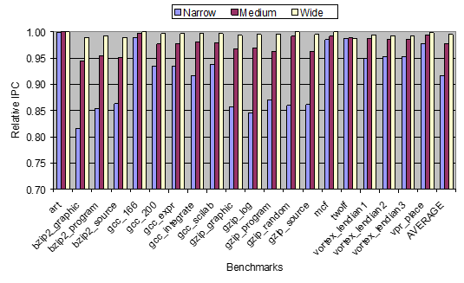
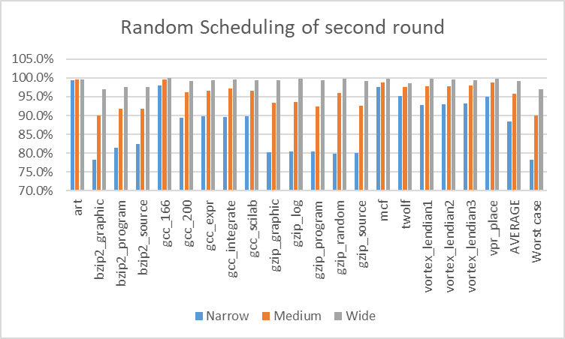
Secure core architecture – Timing attacks
Performance lost due to delayed in commit
Traditionally, we aim to balance all execution paths.
BUT we observed that In out of order (OOO) core
  Instructions are executed in dataflow manner
  Instructions are kept in ROB until can be updated to the architecture state IN-Order (commit time)
  The impact of delaying the commit time on performance is minimal (assuming large ROB)
Thus – the SSC does not need to balance all execution paths – it is enough to make sure that all paths will be committed at time which is not depend on the values it executes.
Performance lost due to random delayed in commit

Slide 24
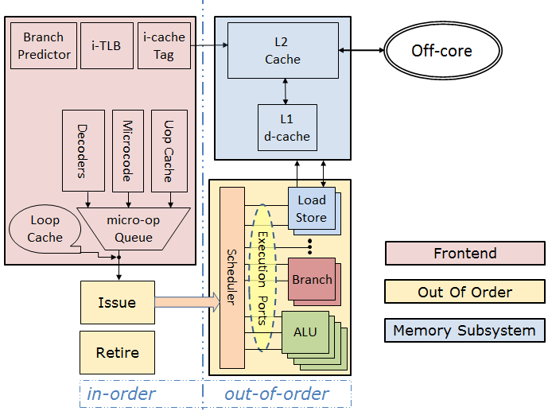
Secure core architecture – Timing attacks
In order to implement a “rapper” that aims to prevent timing attack, we suggest to enhance the current OOO architecture with 2 modules
Time Prediction (TP) – aims to indicate for each instruction (or a group of instructions) when it needs to be committed
  In the paper we describe few mechanisms to implement is
Scheduler assist (SA) – enhanced commit mechanism
Assuming the SA is based on microcode, we can adopt the algorithm to meet future attacks
TP-Time prediction
SA-- scheduling assist
New modules
^{(*)} More details to appear in the SOCC paper

Slide 25
Agenda
Intro
What can we learn from error/fault handling in modern systems
Implications on security
Dynamic protection mechanisms
Example – the SoCure project
Conclusions and next steps

Slide 26
Dynamic protection mechanisms - Detection
Current research we have started focuses on abnormal behavioral detection, such as
  Unexpected changes in timing
    With respect to “golden chip” or temporal change in the behavior
  Sensors to detect unexpected change in voltage, electromagnetic fields, temporal changes in power consumption, etc
The main issue is potential false alarm that may be source for DOS attacks.
Machine learning based solutions are being developed

Slide 27
Dynamic mechanisms - Correction
For know potential attacks we can define reconfigurable mechanism that can re-arrange the system to new known state if an attack happens
For unknown situations we may need to use “self-stabilization” techniques
The research in this direction have just started so we can expect much work toward these directions

Slide 28
Agenda
Intro
What can we learn from error/fault handling in modern systems
Implications on security
Dynamic protection mechanisms
Example – the SoCure project
Conclusions and next steps

Slide 29

A 5 years, 10M$ project that have just started in Singapore.
Building different secure SoC architectures (RISCV based) that include
  Secure Boot
  Secure architecture
  Sensors to detect attacks
  AI based algorithm to analysis dynamic changes; e.g., HTH attacks
  Dynamic respond to unknown attacks
Tap-out few of them
Build a red-team to attack these systems

Slide 30
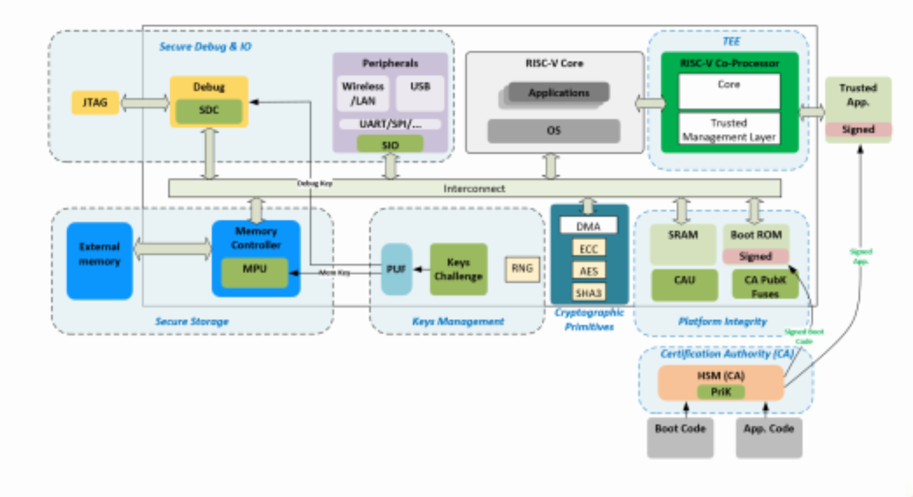
SoCure project
Potential architecture for SoCure,
Proposed by Prof. Anupam Chattopadhyay’s group
We expect to examine many of the dynamic method discussed in this presentation as part of the project
We will work with academic and industrial partners to demo the concepts and prototype/product them

Slide 31
Agenda
Intro
What can we learn from error/fault handling in modern systems
Implications on security
Dynamic protection mechanisms
Example – the SoCure project
Conclusions and next steps

Slide 32
Conclusions
Process technology allows to expand functionality of processors with no significant manufacturing cost.
  It enables the use of dedicated security mechanisms that requires extra logic.
  It also increases complexity and the massive use of SoC design
Many SoCs are built out of un-trustable components
We are approaching the stage where chasing after each single security fault make no sense
We need to start accepting the fact that security faults are part of modern systems – we must develop methodology that allows to have secure systems which are made out of “not always secure parts”.

Slide 33

Conclusions and next steps
In order to build a secure core we need to develop a “design for security” methodology
In this presentation I show one possible alternative to implement such a core
  Preliminary simulations indicates that with minimal cost in performance (<5%) and power (<1%) we can build an high performance secure core.
In the future we will develop dynamic
mechanisms that adaptively change
  Over time
  As new threads get discovered
  As threat changes
Last but not lease, don’t forget -- the
fun have just began

Slide 34

Acknowledgements
Hiroshi Fujiwara cyber security research center, Technion, Israel.
Support from the Singapore National Research Foundation (“SOCure” project) –
NRF2018NCR-NCR002-0001
The team
S Cure

Slide 35
Questions? -- Open Discussion

Slide 36


